Slide 1
EEE 342/ETE418
Control Engineering
Fall 2019
Lecture # 06
30 October 2019

Slide 2



Reduction of Multiple Subsystems
Cascade Form

Slide 3
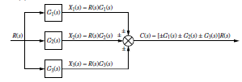

Reduction of Multiple Subsystems
Parallel Form

Slide 4
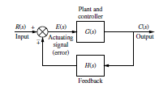
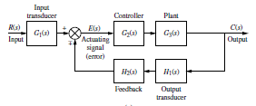


Reduction of Multiple Subsystems
Feedback Form

Slide 5

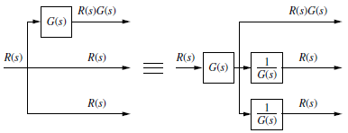

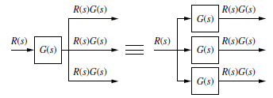
Moving Blocks to Create Familiar Forms

Slide 6
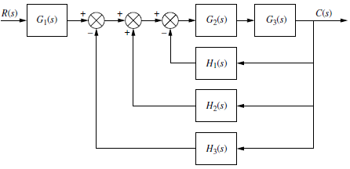

Example 5.1

Slide 7
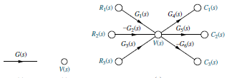
Signal-Flow Graphs

